Slide 1
System Logging / Simple Scripting
Team or presenters name
Date: 26/05/2020
Location: DUB

Slide 2




Virtual Housekeeping
Use
Headsets
Go on
Mute
Participate Actively
Minimize Distractions
Notes:
***Please ensure you have your headset plugged in so we can avoid echoing and maintain audio quality
***Throughout the session, please keep your mic on mute to avoid background noise during the presentation portions.
***Please be aware you will be asked to participate and engage throughout the session. We ask that you are fully active in the chat box, and are also ready to be called on and unmute if needed. We’ll also have you click on some links to view videos, participate in polls and at some point during the session, we’ll be sending you to specific break out rooms depending on which service you’ll be shadowing.
***Lastly, we ask that you’re fully present. Keeping engaged is even more difficult in a virtual setting, so make sure you turn off notifications, maybe set an out of office in your email. Minimize distractions

Slide 3
Course objectives
System logging
Importance of the logs
Location of the logs in Linux Analyzing the file logs
Extracting and Filtering Logs timestamp
Log rotation
journalctl usage and how to make it persistent.
Remote Logging
Simple scripting
Script Basics
Scripts and command execution
Variables
Numeric and string comparisms
File operators and conditional statement
Functions and loops

Slide 4
System logging

Slide 5

Introduction
Why do we need system logging at all:
Troubleshoot issues
Debug application or system behavior
Security auditing
Compliance
Learning
Notes:
Ask question to audience why logging is needed
Troubleshoot issues
Debug application or system behavior
Security auditing
Compliance
Learning

Slide 6
Types of Linux logging
On Linux, you have two types of logging mechanisms :
Kernel logging: related to errors, warning or information entries that your kernel may write. As an example of a Kernel logging [dmesg]
User logging: linked to the user space, those log entries are related to processes or services that may run on the host machine.

Slide 7
Location of the logs
The following are the locations you can check and view the logs in Linux:
Direct Write:
The location of these logs are being set in the application configuration files.
Journald:
All services are writing to journald
rsyslogd:
This is writing into the /var/log.

Slide 8
Analyzing log files
/var/log
time stamp
search for keywords or specific errors
tools:
cat
less
more
head
tail (-f)
Notes:
What do I need for the analysis of a log file?
Type of log file and location
Time stamp or time frame to look for. Otherwise you are looking at information not related to the incident
A log file can be quite extensive with multiple MB not being unusual. Knowing the time stamps or a specific keyword or error to look for is very helpful
A tool to read the text file. You should all be familiar with multiple of them by now.
Depends on the preference.
tail with the option –f is very useful for keeping track of changes in a log file (can do a short demo of this)

Slide 9
Extracting and Filtering
Grep and pipe (|) is your friend
Grep searches for a string
Pipe (|) uses the ouput of one command as the input for the next command
cat /var/log/messages | grep dhclient | less
Notes:
You will want to focus on the important information in a log file.
Also if you are sending on log files to other people, they do not value your 1GB log file from the last 4 weeks.
So how do we filter and extract information.
(pipe has already been covered in previous session)
grep searches for string or also regular expressions and is often used in conjunction with | to redirect the STDOUT to another commands STDIN
An example here to extract all information regarding the dhcpclient from /var/log/messages and displaying them in less

Slide 10
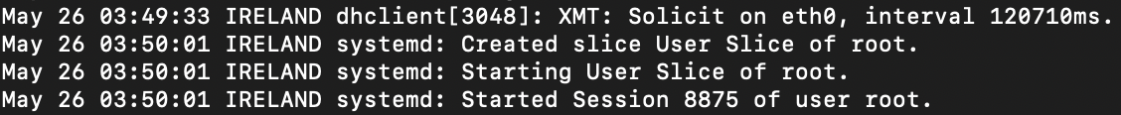
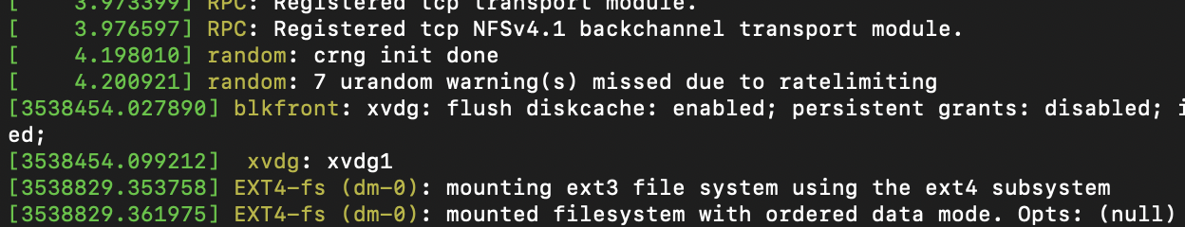
Time Stamps
Notes:
(Explain importance of time stamps)
Different time stamps in some log files
most of them will show a known time format of month/day/time.
Dmesg shows hardware and boot information and time stamp is in seconds after reboot
(do a little whiteboard calculation)
How do you know how long linux has been running?
Uptime -sp
Some time stamps might also be in so called EPOCH, which is the time in seconds since 01/01/1970
There are EPOCH converters on the internet so I don’t encourage you todo the maths yourself there
Time zone very important, otherwise you don’t know where to search for entries on log file

Slide 11
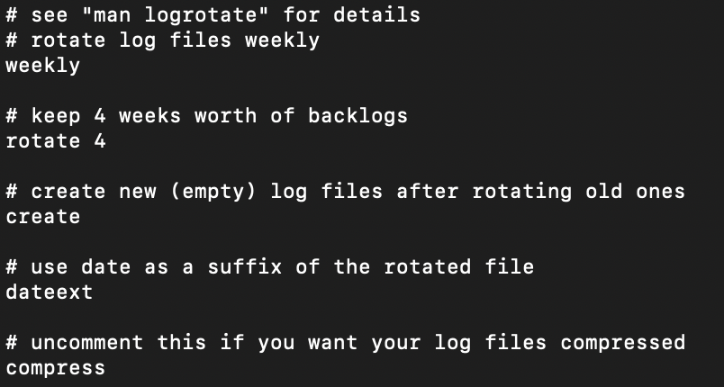
syslogd and logrotate
Central daemon for collecting and writing log information
Config under /etc/rsyslog.conf or /etc/rsyslog.d/
Notes:
logrotate is responsible for rotating the logs after a configurable amount of time, compress them and discard older log files alltogether.
This is done so that one log file does not grow too large over time, which makes it hard to open and navigate
provide support for system logging and kernel message trapping. Support of both internet and unix domain sockets enables this utility package to support both local and remote logging.
This is basically the interface between the application which is trying to send a message and the log file where this message is stored.
syslogd does receive the information from the kernel or application and then processes them in a standardized format to either store them locally or to send them on to a remote logging server.
You will sometimes see syslogd showing up as rsyslog, which stands for rocket fast syslog server, but has the same functionality
Configuration under rsyslog.conf and in the directory rsyslog.d, but it is very rarely touched these daus
logrotate configuration files are under /etc/logorotate.conf
You can see an example entry here, to give you an idea
the log files are rotated weekly, kept for 4 weeks
new log files are created and old ones get an added suffix of the date
3) log files are not being compressed You can configure this to your liking

Slide 12
Become a logging adept (exercise)
Look at the configuration files:
/etc/logrotate.conf
/etc/rsyslog.conf
Calculate the time of the last entry in dmesg
Explore /var/log directory
Filter your messages log by the word “error”
Notes:
(consider this optional depending on your time management, can be postponed until end of session))
First activity:
Become a logging adept
This is for getting used to the configuration, how to read log files, translate different timestamps, explore the different log files in /var/log, filtering and monitoring

Slide 13
journalctl
Journalctl is used to read all logs
Stored under /var/log/journal
All files are binary
Quicker and more efficient way to read and write
Controversial / rsyslog compatability
Notes:
journalctl is present in systemd and technically replaced the syslogd/logrotate and /var/log text based log files
You should now all be familiar with systemd and SysVinit.
So what does this mean for?
Instead of using different log files and reading tools like cat,tail,head,more,less there is only journalctl
It is like systemctl for logging
If the command is present, the system uses journalctl
All files are stored under /var/log/journal, but they are all binary, means you can’t read them without journalctl
It is faster and more efficient when reading and writing large log files
Quite controversial, some would say shitstorm, since admins are used to text files and a lot of tools depend on it
That’s why still nowadays in all big distributions, the is a rsyslog compatibility integrated
So you can ignore it if you really want to, but journalctl is the way forward
So let’s have a look how this works…

Slide 14
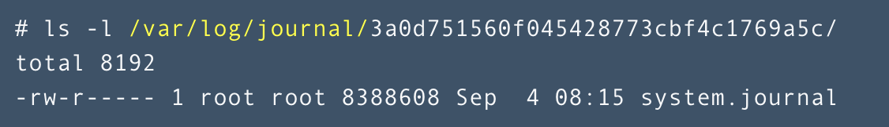
journalctl “continued”
All boot operations that are written into the journald are not persistent.
Sometimes, you might need to debug service startup issues during the boot. In that case you can use the persistent mode:
Change the "/etc/systemd/journald.conf" Storage=persistent
This will allow the boot logs to be saved on a disk like /var/log/journal. However, the directory must already exist and have the proper permissions set. If it does not exist, then journal data is stored in the volatile /run/log/journal/ directory, and the data is erased when the system shuts down.

Slide 15
Examples of journalctl
journalctl -ef
journalctl --since 13:00 --until 14:00
journalctl -u sshd.service
journalctl -p emerg..err
echo 'hello' | systemd-cat -t someapp -p emerg
Notes:
Everything (almost) is done with the journalctl command
(explain examples or yet better do a demo)
works like tail –f
time based search
show only entries for sshd service
show only error of severity error to emergency
send a message to the new journalctl (if you want to)

Slide 16
Logging Exercise
How to log all Bash commands by all users on a server using the rsyslog?
Notes:
How to log all Bash commands by all users on a server using the rsyslog?
Ask the following question, make them check online, and know how to use the rsyslog to log the commands executed by the users:
How to log all Bash commands by all users on a server?
For BASH shells, edit the system-wide BASH runtime config file:
sudo -e /etc/bashrc
Append to the end of that file:
export PROMPT_COMMAND='RETRN_VAL=$?;logger -p local6.debug "$(whoami) [$$]: $(history 1 | sed "s/^[ ]*[0-9]\+[ ]*//" ) [$RETRN_VAL]”’
Set up logging for "local6" with a new file:
sudo -e /etc/rsyslog.d/bash.conf
And the contents below:
local6.* /var/log/commands.log
Restart rsyslog:
sudo service rsyslog restart
Log out then Log in

Slide 17

Privacy awareness
#1) Respect the privacy of others.
#2) Think before you type.
#3) With great power comes great responsibility.
Notes:
(optional slide)
This is the sudo message when executing root commands
log files might contain sensitive information that you either should not see or do not want to see.
keep this in mind when crawling through log files on a server or when asking customers for logs to remove sensitive information
Mail server and proxy server log files might contain information that you have access to but don’t want to see.

Slide 18
Remote logging / CloudWatch
Keeps all logs in one single place
Old school via rsyslogd or journalctl
But really, almost everybody uses a dedicated tool
Like cloudwatch
(optional exercise)
Notes:
When you have hundreds or thousands or hundreds of thousands of servers, you don’t log into them individually for the logs
So you want them in a central location
Can be done via rsyslogd and journalctl, but really nobody does that and everybody uses dedicated monitoring and logging tools
Since we are at AWS, cloudwatch is a good example for a well used tool to centralize logging
(ask audience if they are aware of cloudwatch)
(optional exercise here to push logs from EC2 linux to cloudwatch)
https://docs.aws.amazon.com/AmazonCloudWatch/latest/logs/QuickStartEC2Instance.html
Steps:
1) Use or create an amazon linux 2 EC2 instance
2) Open the IAM console at https://console.aws.amazon.com/iam/.
3) In the navigation pane, choose Roles.
4) Click “create role”
5) Under “Choose the service that will use this role” choose EC2.
6)On the next page select “AmazonEC2RoleforSSM “, tick the box next to it and select next twice
7) Choose a name and click “create role”
8) In the EC2 console, right click your instance, choose “instance settings” and “add/replace IAM role”
9) Choose the role created previously and attach it
10) Log into the instance via ssh
11) sudo yum update –y
12) sudo yum install -y awslogs
13) (optional) Edit the /etc/awslogs/awslogs.conf to include more log files
14) (optional) Edit /etc/awslogs/awscli.conf to change the region from us-east-1
15) sudo systemctl start awslogsd
16) Check your cloud watch console and choose logs in the configured region (might take a minute or two)
Check /var/log/awslogs.log for any errors.

Slide 19
Simple Scripting

Slide 20
simple scripting
task automation
iteration
scheduling
flexible
bash
php
javascript
perl
python
Notes:
Ask audience what are the advantages of scripting?
There are many, but one of the most important are:
You can automate tasks with it, meaning you don’t have to type the same command into the command line every time
You can make changes easily and creates different versions of scripts
You can schedule to run a script at predefined times or based on conditions
very flexible, so you can customize your script to your needs
They can range from very simple and a few lines to very complex including variables, loops, branching, functions, comparism and much more.
While we do have a vast amount of possible languages available to us, we will be focusing on bash scripting here for the basics.
python has also become very popular in the last years to use on linux and other operating systems
(examples to follow were adapted from https://linuxconfig.org/bash-scripting-tutorial-for-beginners)

Slide 21
scripting basics
scripts end in .sh
scripts need to be executable
relative and absolute path (./script.sh)
shebang at the start (#!/bin/bash)
# this is a comment and incredibly useful
save often
exit status codes
Notes:
Some general points to keep in mind when creating a script
scripts do generally have the ending .sh. This is not mandatory and linux or bash doesn’t care about this at all, but it’s a nice indicator for humans to guess that this is indeed a script
scripts need to be executable, so don’t forget that executable bit
keep the relative and absolute path in mind when executing the script and referencing commands inside the script. if in doubt use the full path or a variable
In order to know which shell to use, the first line of every bash script has to be the shebang
use comments, they help you and other people even more
before changing a script, it’s a good idea to have a backup with the last known working state
scripts just like commands do have an exit code. This is a number at the end of the execution. A 0 indicates no issues. Everything other than 0 indicates a problem of some sorts
it is stored in the variable $! (echo $!)

Slide 22


simple command execution
Notes:
#!/bin/bash
cp -r /var/www/html /mnt/backup/
(this is the little script being used in crontab exercise in previous session)
in it’s simplest form, you just put a command into a file.
We can see that the default web server directory has now been copied to /mnt/backup, basically making a backup of of our web server files
Now there is some potential for improvement, since we do not get any feedback, backups simply overwrite, we don’t have a time stamp.
Also we did not include config or log files and have a static path. Lets try to fix this as we go along and introduce new elements
next up is variables

Slide 23
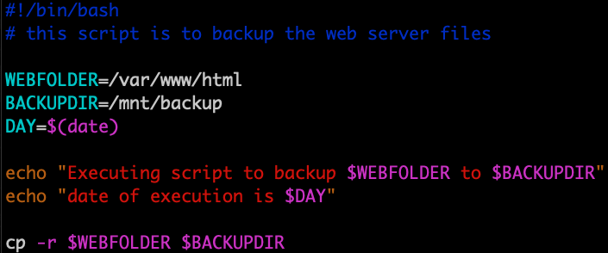

Variables
Notes:
You have already learning about variables in one of the first sessions.
So let’s see how we can use them to our advantage.
In this case we want to make the script also print out the time when the backup was being created along with some more information
here we do add a comment in line 2 to state what the script is actually doing
we then define the folder in a variable, as well as the day, which we get from the date command
we then echo out some information to STDOUT using the variables defined beforehand
we then use the variables again in the actual copy command
Variables are usually in all capital letters as a convention. Technically, it does not matter
Since we want to keep backups easily manageable and also compress them where possible, let’s do a little detour here
#!/bin/bash
# this script is to backup the web server files
WEBFOLDER=/var/www/html
WEBFOLDER=/mnt/backup
DAY=$(date)
echo "Executing script to backup $WEBFOLDER to $BACKUPDIR"
echo "date of execution is $DAY"
cp -r $WEBFOLDER $BACKUPDIR

Slide 24
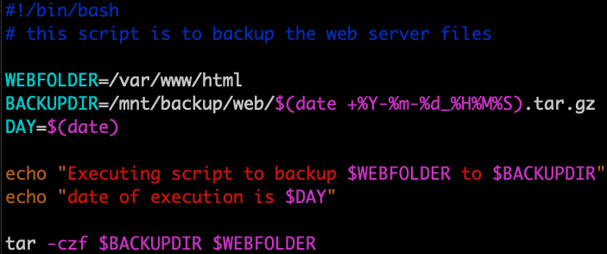
backup via tar
Notes:
GNU `tar' saves many files together into a single tape or disk archive, and can restore individual files from the archive.
It’s like a zip file in Windows
Especially useful if working with a lot of files.
Has additional options to enable compression.
tar option used:
c for create
z for compression
f to indicate file name
This way we have a single compressed file which now also has a date in a format that we can order it easily in ls to get the latest one
(add 2> /dev/null to tar command to get rid of message about leading `/’)
#!/bin/bash
# this script is to backup the web server files
WEBFOLDER=/var/www/html
BACKUPDIR=/mnt/backup/web/$(date +%Y-%m-%d_%H%M%S).tar.gz
DAY=$(date)
echo "Executing script to backup $WEBFOLDER to $BACKUPDIR"
echo "date of execution is $DAY"
tar -czf $BACKUPDIR $WEBFOLDER

Slide 25
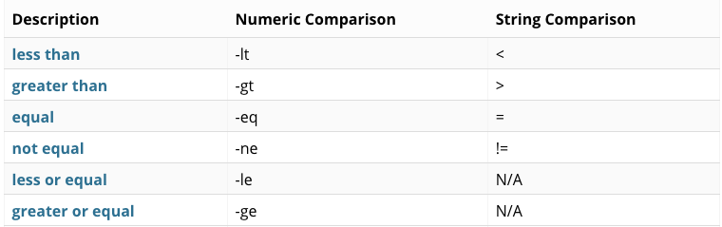
numeric and string comparisms
num_a=100
num_b=100
[ $num_a -eq $num_b ]
echo $?
0
Notes:
We can use numeric and string comparism to determine if a string or number is for example equal/not equal or lesser or greater
The example on the left has two numbers in a variable, num_a and num_b
Both are a numeric value of 100
We then need to use brackets in order to execute the comparism in bash.
Here we are asking if the numbers are equal
The echo $! does return the exit code and is 0 for true and 1 for false
using this with conditional statements will make much more sense. So lets have a look at them

Slide 26
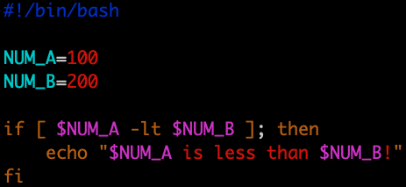

conditional statements
Notes:
conditional statements or sometimes called branching will execute code based on certain conditions
This is widely used with if/else/fi loops
So lets use an example with a numeric comparism and a conditional statement
We have two number stored in the variables, 100 and 200
Then we start the conditional statement with “if”
So if 100 is less than 200 then execute then continue execution.
Otherwise jump to the the next part of the statement, which in this case is fi and indicates then end of the statement.
The use if an else is optional.
#!/bin/bash
NUM_A=100
NUM_B=200
if [ $NUM_A -lt $NUM_B ]; then
echo "$NUM_A is less than $NUM_B!"
fi
How can we use this now in our backup script?
Lets include some sanity checks and harden the script

Slide 27
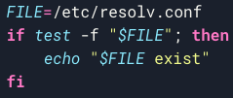
file operators
-d FILE - True if the FILE exists and is a directory.
-e FILE - True if the FILE exists and is a file, regardless of type
-f FILE - True if the FILE exists and is a regular file
Notes:
We can also test if a certain file does exist or even check if it’s an expected type
The ones most commonly used are
-d
-e
-f
How does this look in application?
Before we are interacting with any type of files, we want to check they are actually present.
This is also useful if we are not sure of the name or directory and have to look in multiple places
In this example we are checking if /etc/resolv.conf is a regular file, which it is indeed
There is a number of file operators:
https://www.tldp.org/LDP/abs/html/fto.html
So how can we apply all of this new knowledge to our script now ?

Slide 28
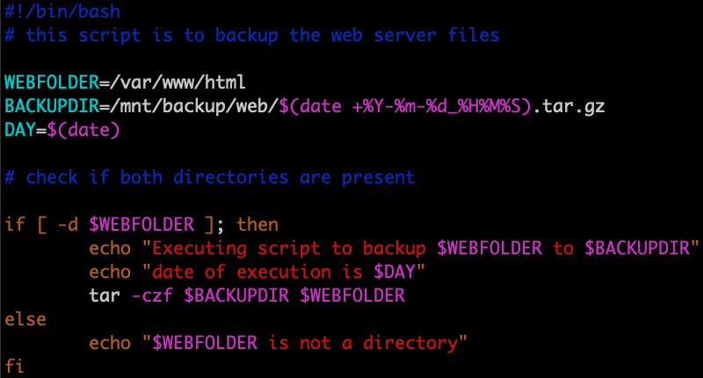
in application
Notes:
Let us include some sanity checks to harden the script
#!/bin/bash
# this script is to backup the web server files
WEBFOLDER=/var/www/html
BACKUPDIR=/mnt/backup/web/$(date +%Y-%m-%d_%H%M%S).tar.gz
DAY=$(date)
# check if both directories are present
if [ -d $WEBFOLDER ]; then
echo "Executing script to backup $WEBFOLDER to $BACKUPDIR"
echo "date of execution is $DAY"
tar -czf $BACKUPDIR $WEBFOLDER
else
echo "$WEBFOLDER is not a directory"
fi

Slide 29
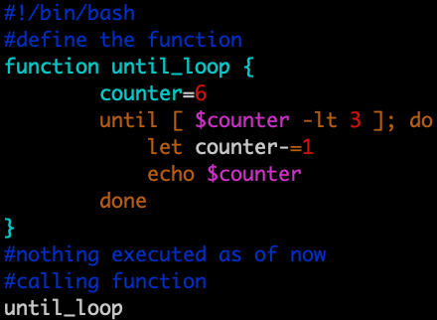
functions
function <name> {
#do something
}
<name>
Notes:
Functions allow a programmer to organize and reuse code, hence increasing the efficiency, execution speed as well as readability of the entire script. It is possible to avoid using functions and write any script without including a single function in it. However, you are likely to end up with a chunky, inefficient and hard to troubleshoot code.
Functions only really become useful on larger scripts, but try to incorporate them from early on, since you never know if your script might stay at 5 lines or will get continuously worked on and expanded.
We can see an example here using the loops we just covered

Slide 30
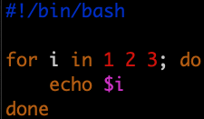
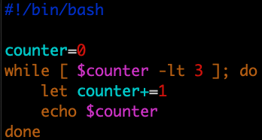
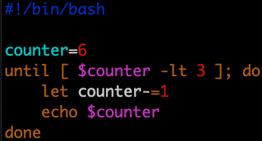
loops
for
while
until
output
Notes:
Loops generally help to execute pieces of the code multiple times. There are a number of different loops suited for different purposes.
Some examples are:
for
while
until
An example is for do done
Let’s have a look at them
(go through them and have student explain the outpout)

Slide 31
You should now be familiar with…
system logging
simple scripting
(optional scripting lab)
Notes:
Where to go from here?
I encourage you to work on a backup script yourself and to try to automate other system administration tasks
All the scripts shown here are also in the comment of the slides available.
The examples here are by no means perfect but should give you a good starting point in scripting and ideas to come back to if needed.
Try to make the script run every day automatically, include multiple folders, give more verbose information about the files and folders and size of them backed up.
You can create a backup logfile which you then automatically uploads to cloud watch logs, which you can then analyze and connect to an SNS topic.
More on AWS services in the coming weeks
more stringent version of the exercise
make interactive script to ask use which directory to backup
backup the folder or file to S3
create a log file to record any actions done
implement error logic to make sure directory is valid
In general, if you’re having issues with your script, you can include ”set –x” at the start of the script after the shebang.
I adds verbosity and basically prints the tracing of the commands inside the script. Set is a bash builtin function like echo.
Scripts are also often used here in AWS for the AWS CLI or the AWS SDK.
(if not done already, the log labs can be used now in slide 8 and 12)

Slide 32
scripting exercise
make interactive script to ask use which directory to backup
backup the folder or file to S3
create a log file to record any actions done
implement error logic to make sure directory is valid
Notes:
skeleton
#!/bin/bash
aws=`which aws`
Read -p “enter dir to backup” dir
Read -p “S3 bucket name” bucket
Aws s3 cp $dir s3://$bucket >> /home/ec2-user/upload.log 2>$1
https://docs.aws.amazon.com/cli/latest/userguide/cli-services-s3-commands.html
https://docs.aws.amazon.com/cli/latest/userguide/install-cliv1.html#install-tool-pip

Slide 33
Insist on the highest standards
Please take 2 minutes to complete the survey to let us know what you liked about the training and what can be improved.
This will help us to continue creating helpful and relevant training content.
Link is in the invitation email.

